Slide 1
Computer Vision
Part 2: Hyperparameter and Data Handling
ADF

Slide 2
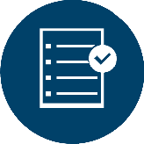
Agenda
Part 1: Review on Digital Image Processing and Visual Recognition System
Part 2: Review on Hyperparameter and Data Handling (Train, Test, Validation)
Part 3: Review on Linear Classification
Computer Vision

Slide 3
Data Handling for Hyperparameter Tuning
Computer Vision

Slide 4
Data Handling
Data Preparation
Data Preprocessing
Computer Vision

Slide 5
Data Preparation
dataset
BAD: No idea how algorithm
will perform on new data
train data |  |  |  |  | test data
Split data into train, val, and test; choose
hyperparameters on val and evaluate on test
train data | Validation data | test data
Computer Vision
Notes:
Do not try out what hyperparameters work best on test set
Split your training set into training set and a validation set. Use validation set to tune all hyperparameters. At the end run a single time on the test set and report performance.

Slide 6
Types of Dataset
Train set
Use to train the model
Validation set (dev set)
Use to tune (find the best) Hyperparameters
Computer Vision

Slide 7
Types of Dataset
Test set
Proxy for generalization performance
Should not use while observation
Forget you even have it
Use only very sparingly at the end
To check how well the model in generalizing the unseen data point
Evaluate on the test set only a single time, at the very end
Computer Vision

Slide 8
Science is often about Refining Questions and Removing Variables
Computer Vision

Slide 9
Observing Data Split
Not Fair
train data |  |  |  |  | test data
train data |  |  |  | test data
train data |  |  | test data
train data |  |  |  |  | test data
train data |  |  |  |  | test data
train data |  |  |  |  | test data
Fair
Computer Vision

Slide 10
Using Validation
Single Validation Split
Random Cross Validation
K-Fold Cross Validation
Dataset
test
train
Done once
Observation loop
train
val
Computer Vision

Slide 11
Cross Validation
Dataset
Dataset
test
train
loop
loop
Random shuffle
Random shuffle
Evaluate
train
test
Train Further
train
val
?
Hyperparameter observation loop
Hyperparameter observation loop
evaluate
Computer Vision

Slide 12
K-Fold Cross-validation
Useful incase of small training data (not used too frequently in DL)
fold 1 | fold 2 | fold 3 | fold 4 | fold 5 | test data
fold 1 | fold 2 | fold 3 | fold 4 | fold 5 | test data
fold 1 | fold 2 | fold 3 | fold 4 | fold 5 | test data
Computer Vision
Notes:
split the training data into 5 equal folds, use 4 of them for training, and 1 for validation. We would then iterate over which fold is the validation fold, evaluate the performance, and finally average the performance across the different folds

Slide 13
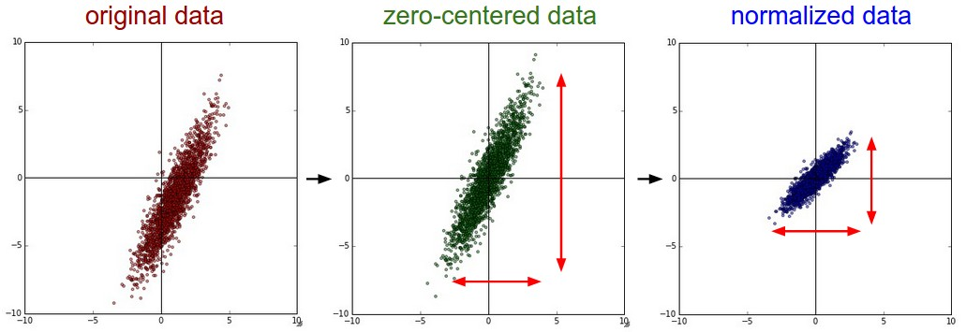
Data Preprocessing
Zero-centered data : Subtract the mean
Normalize : divide with standard deviation
Computer Vision
Notes:
In computer visual did not do PCA and Whitening

Slide 14
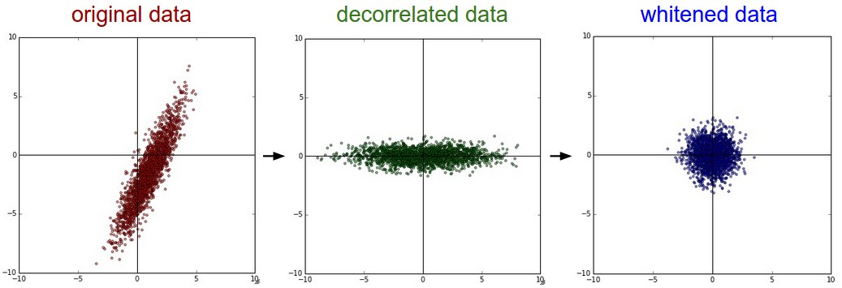
Data Preprocessing
Going Further: PCA and Whitening
Computer Vision
Notes:
In computer visual did not do PCA and Whitening

Slide 15
Data Preprocessing
Careful : any preprocessing statistics (e.g. the data mean) must only be computed on the training data, and then applied to the validation / test data
train
Preprocess
Preprocessed train
Dataset
train
Preprocess
Dataset
val
Preprocess
Preprocessed val
val
test
Preprocessed test
test
Preprocess
Computer Vision

Slide 16
Data Preprocessing
Careful : any preprocessing statistics (e.g. the data mean) must only be computed on the training data, and then applied to the validation / test data
Preprocess and store statistics
train
Preprocessed train
Dataset
val
Preprocess using trainset’s statistics
Preprocessed val
test
Preprocessed test
Computer Vision

Slide 17
Break, Question?
Computer Vision

